Slide 1


Unpacking the synergy of physics and data in atomistic systems
Jigyasa Nigam
November 2025
Computational Materials Physics Seminar
University of Vienna

Slide 2
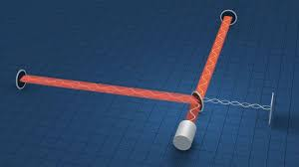
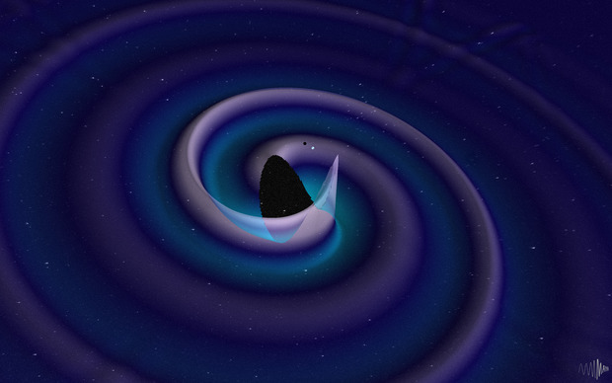
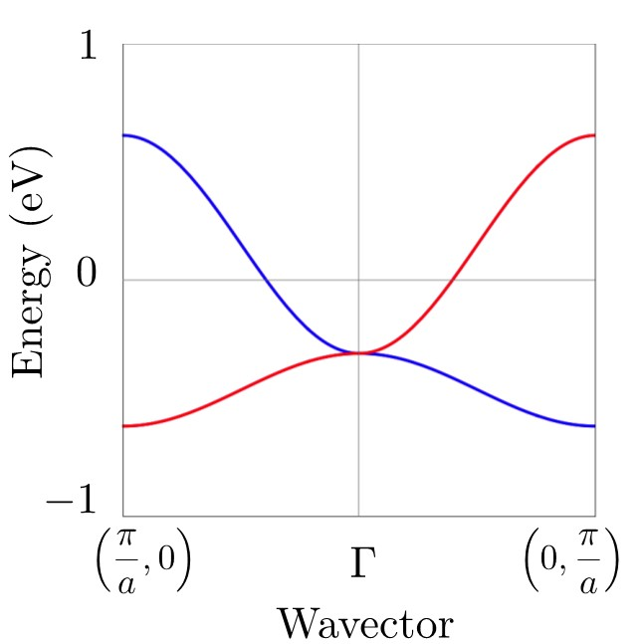
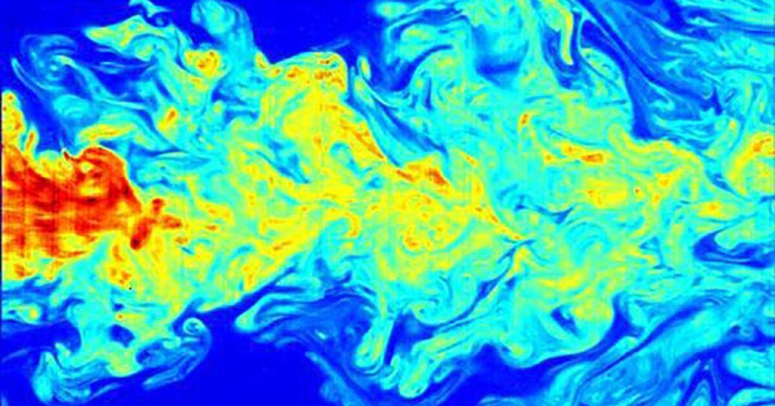
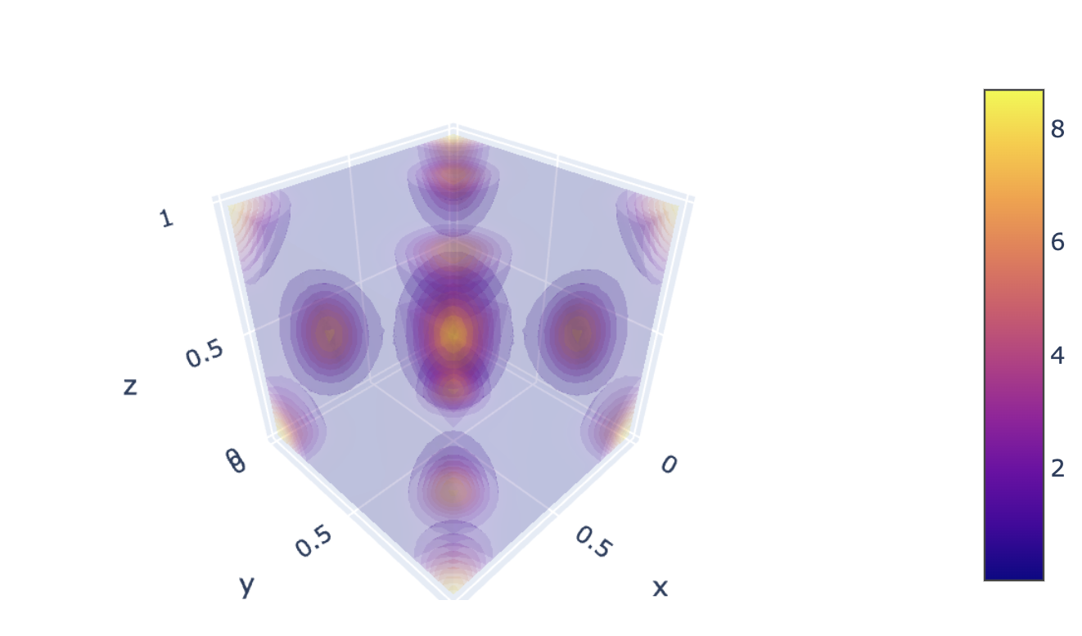
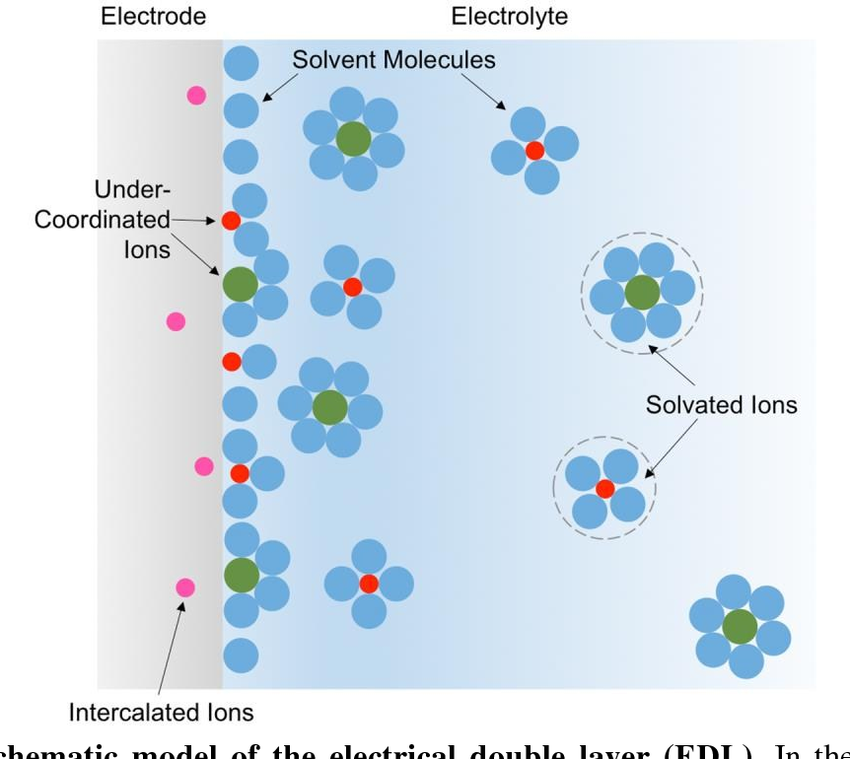
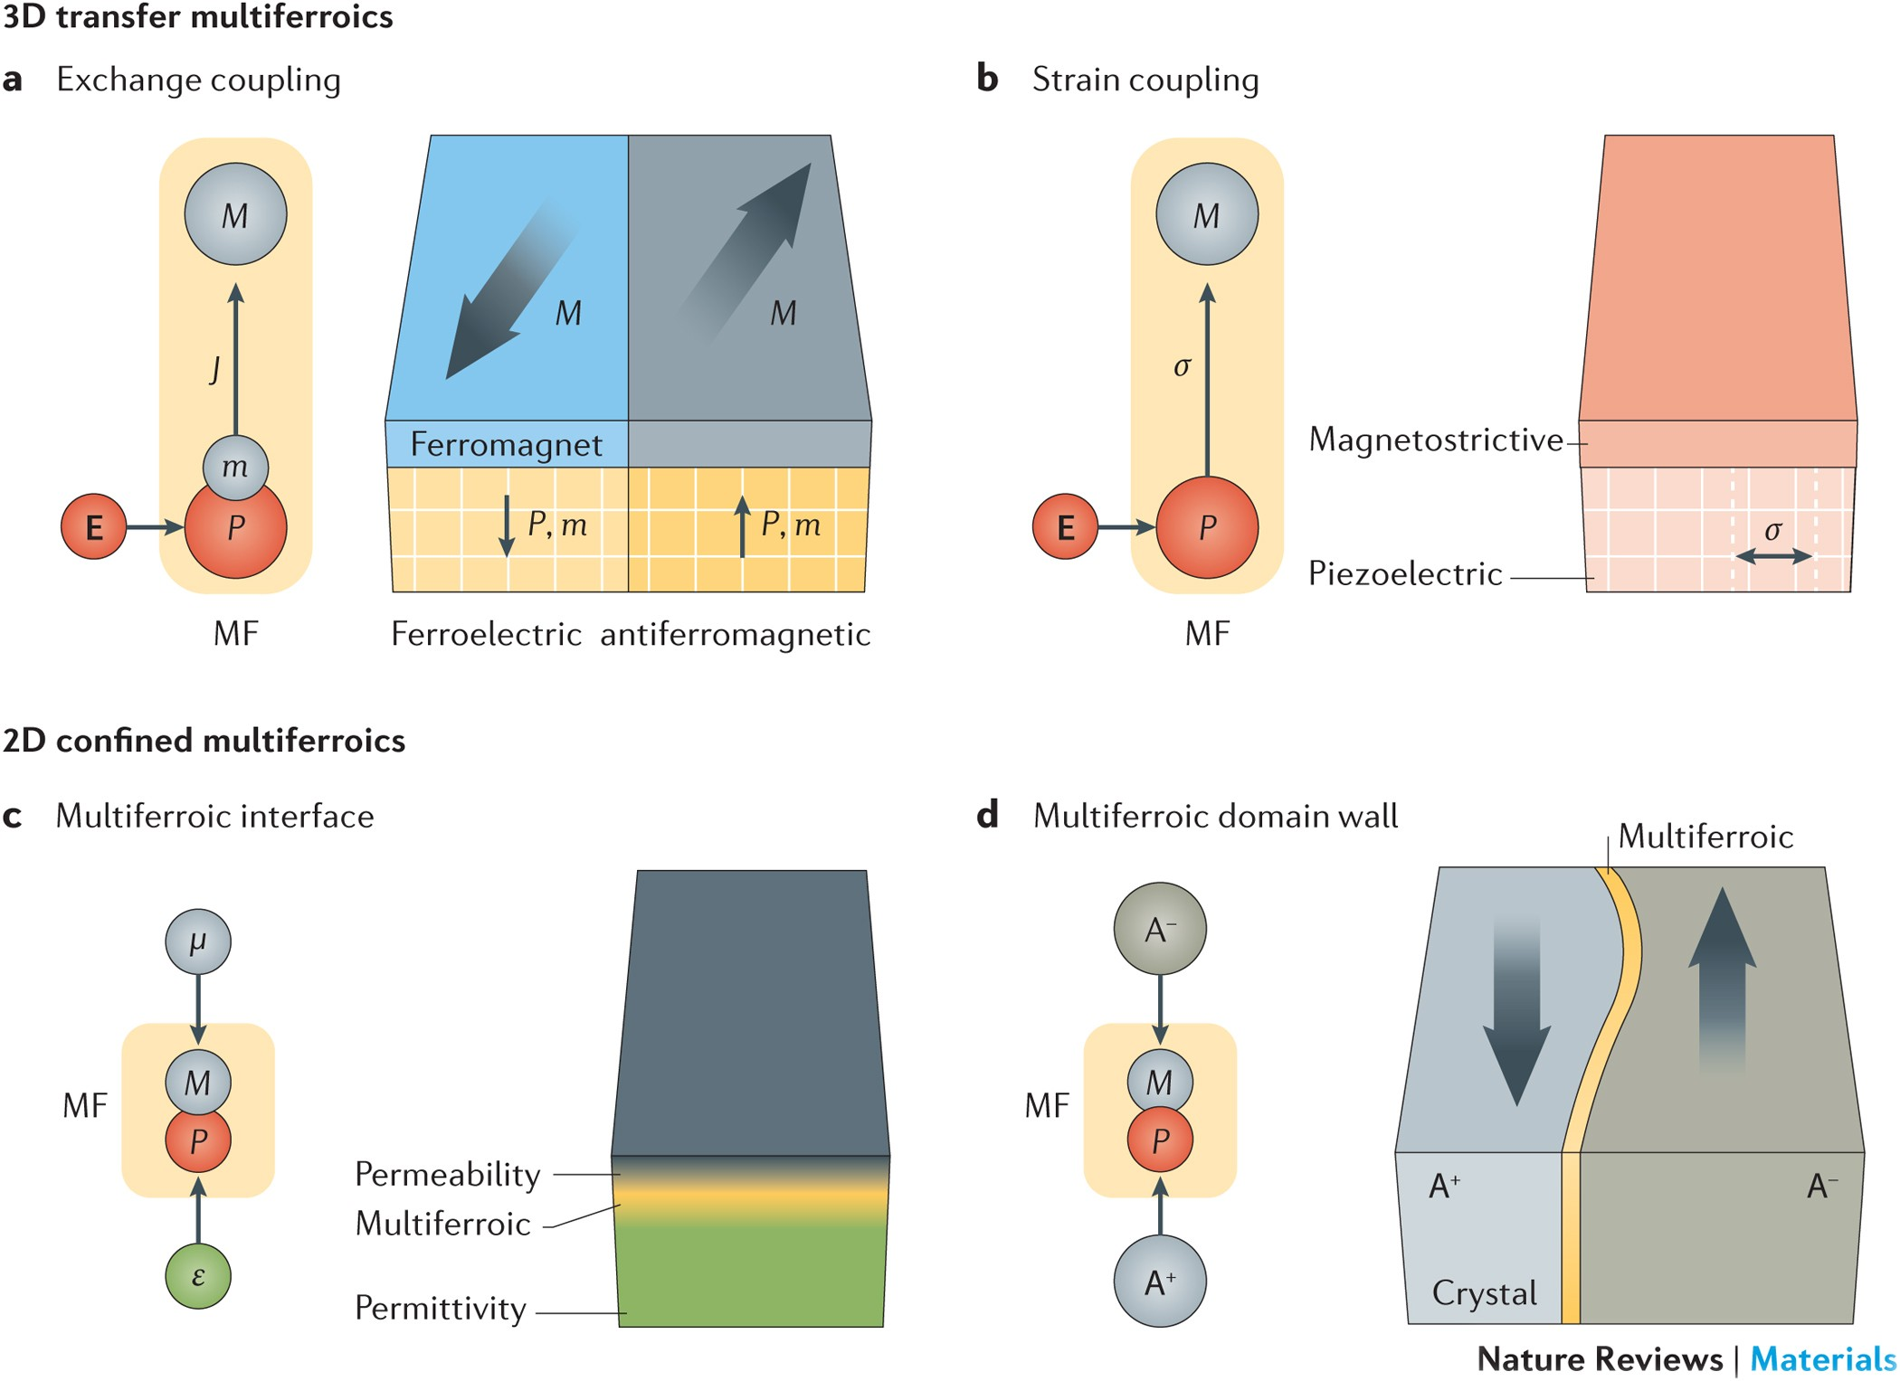
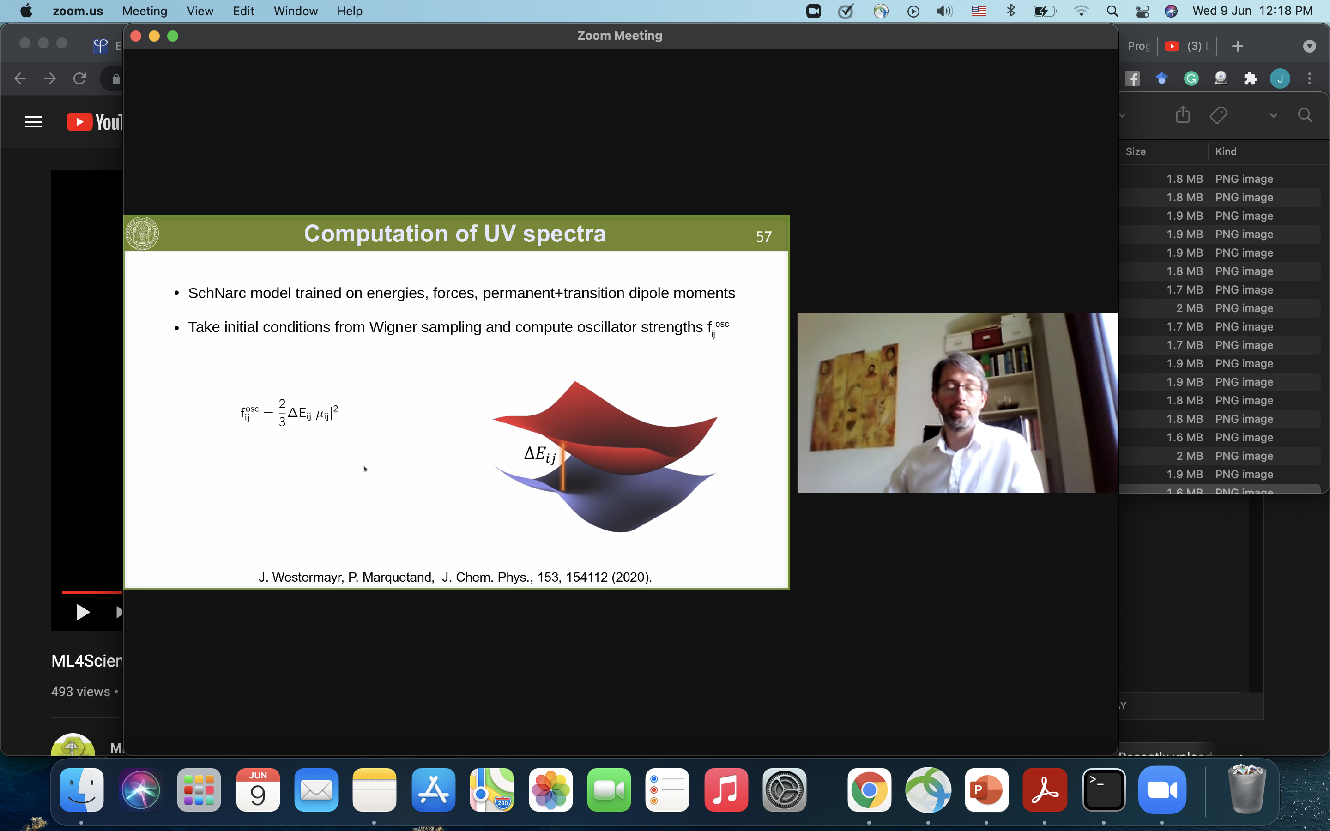

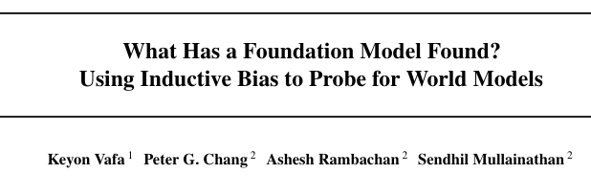
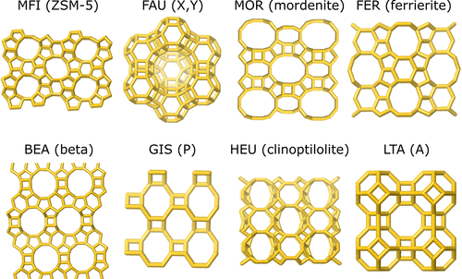
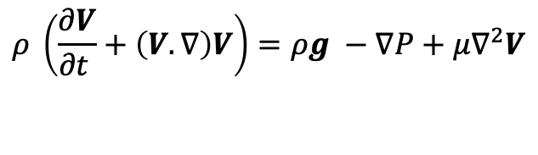

ML for physics, physics for ML
LIGO Interferometer design
Altermagnetism
$$ρ \left(\frac{∂V}{∂t }+\left(V. ∇\right)V\right)=ρg −∇P+μ∇^{2}V$$
Catalysts
Novel material synthesis
$$\hat{H}ψ=Eψ$$
PCCP, 2015
Energy storage and conversion
Courtesy Julia Westermayr
Nature Reviews Materials, 2016
New phases and memory
Efficient energy absorption
arXiv 2507.06952
1. Solve problems with known equations that are hard to solve
2. Discover “new” physics from data

Slide 3




A mutually beneficial exchange between science and ML
A strategy to
“learn”
from
data
Software advances
Hardware
improvements
Availability
of high
quality
data
Theoretical & Experimental scientific advances
Levine et al. (2025)

Slide 4
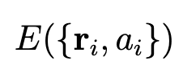
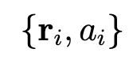

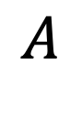
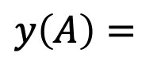
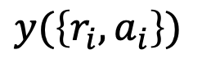
ML for materials, historically
$$y\left(A\right)=$$
$$y(\left\{r_{i}, a_{i}\right\})$$
Quantum Mechanical (QM) calculation
$$A$$
$$F_{i}=−∇_{i}E$$

Slide 5

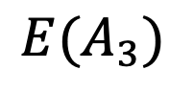
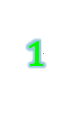
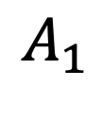

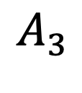
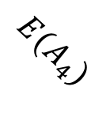

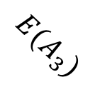

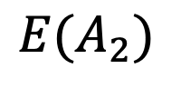
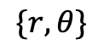

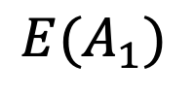
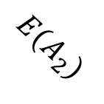

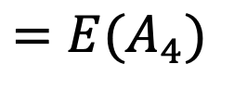

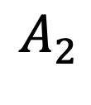
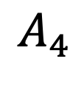
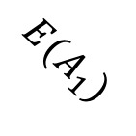

A rose by any other name, smells just as sweet
$$A_{1}$$
$$A_{2}$$
$$1$$
$$2$$
$$E(A_{3})$$
$$E(A_{2})$$
$$4$$
$$3$$
$$E(A_{2})$$
$$E(A_{1})$$
$$1$$
$$A_{4}$$
$$A_{3}$$
$$E(A_{1})$$
$$4$$
$$2$$
$$=E(A_{4})$$
$$E(A_{4})$$
$$\{r,θ\}$$
$$E(A_{3})$$
$$3$$

Slide 6
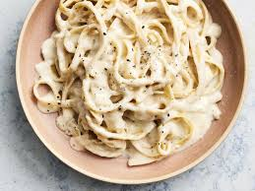
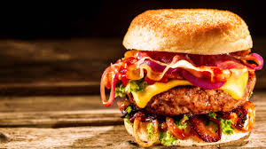
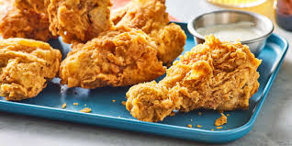
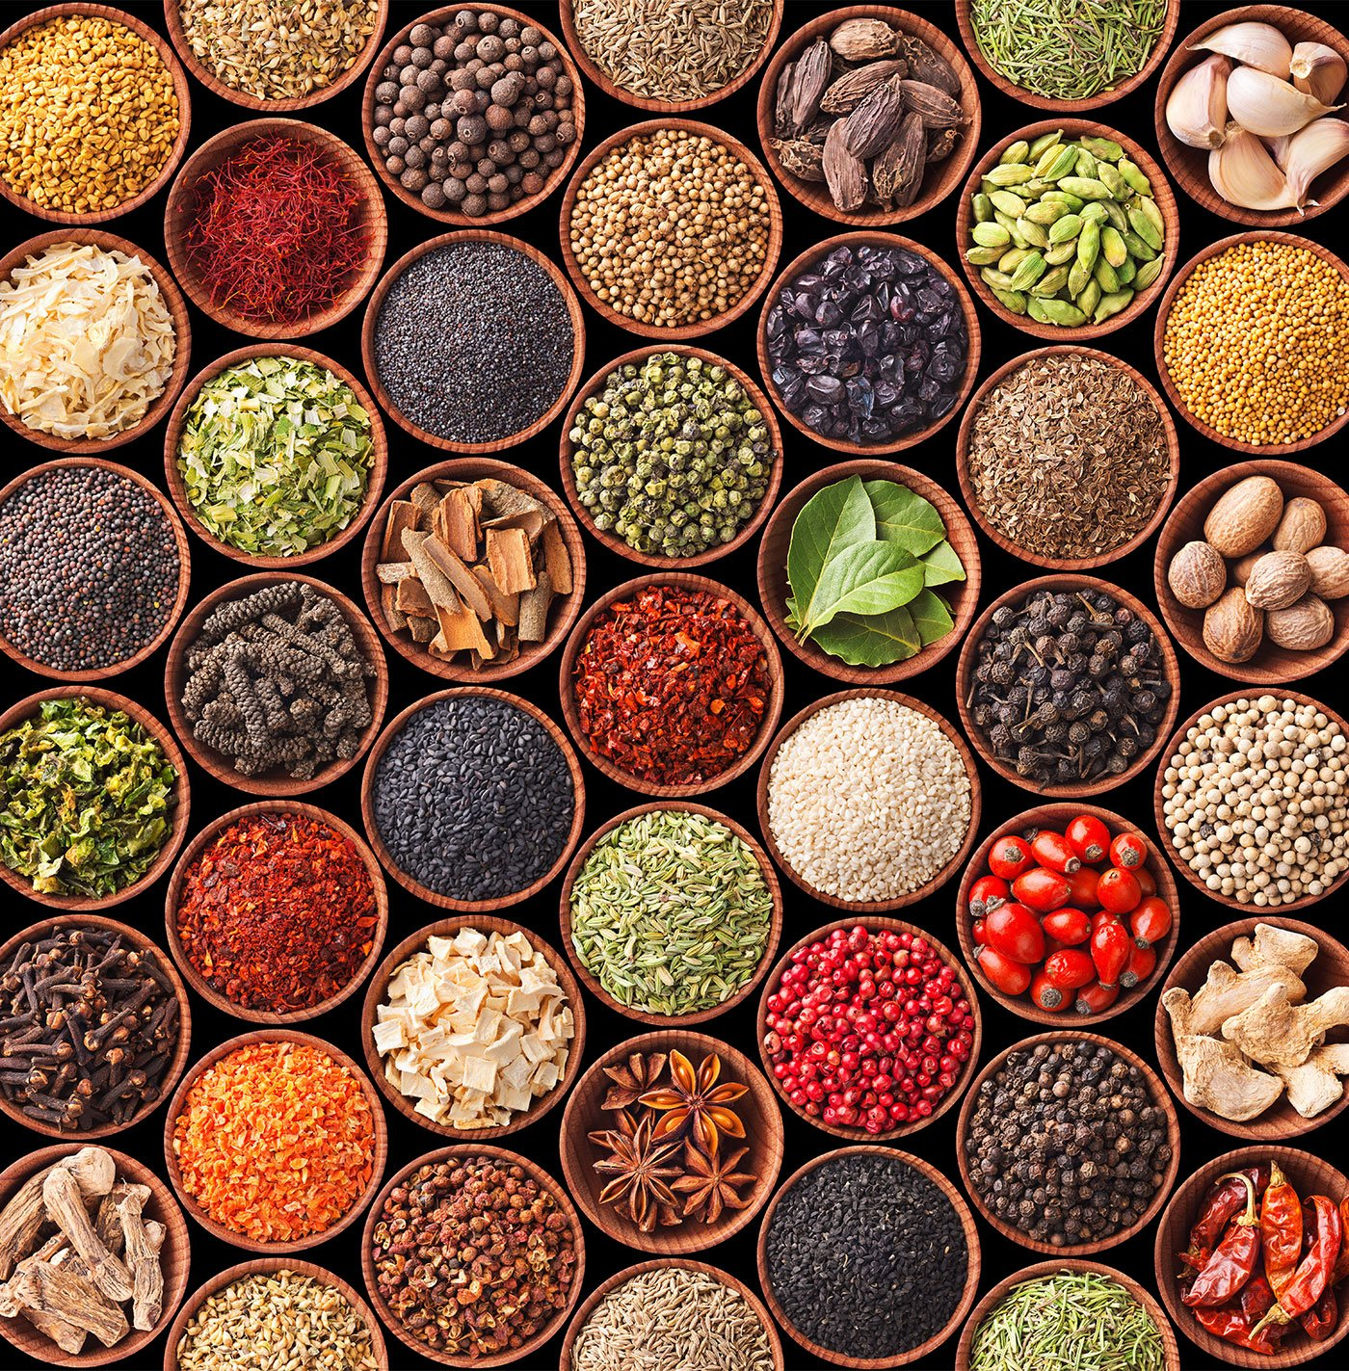
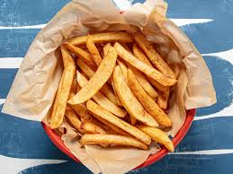
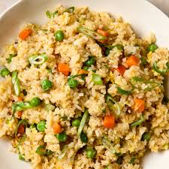
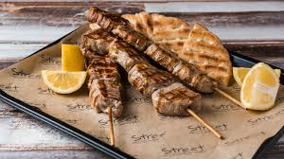
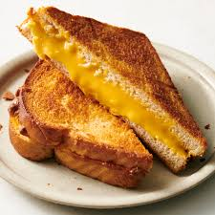
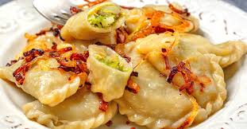

Unlocking the secret recipe
Variety is the spice of life
The interatomic potential model menu
Can we identify ingredients of successful models and try to make the “best” recipe out there?
NeQUIP
MACE
Torch-MDNet
SEGNN
ANI
GAP
Cormorant
Behler-Parinello
DimeNet
Notes:
I’ve tasted these all, but I always felt like something’s missing…

Slide 7
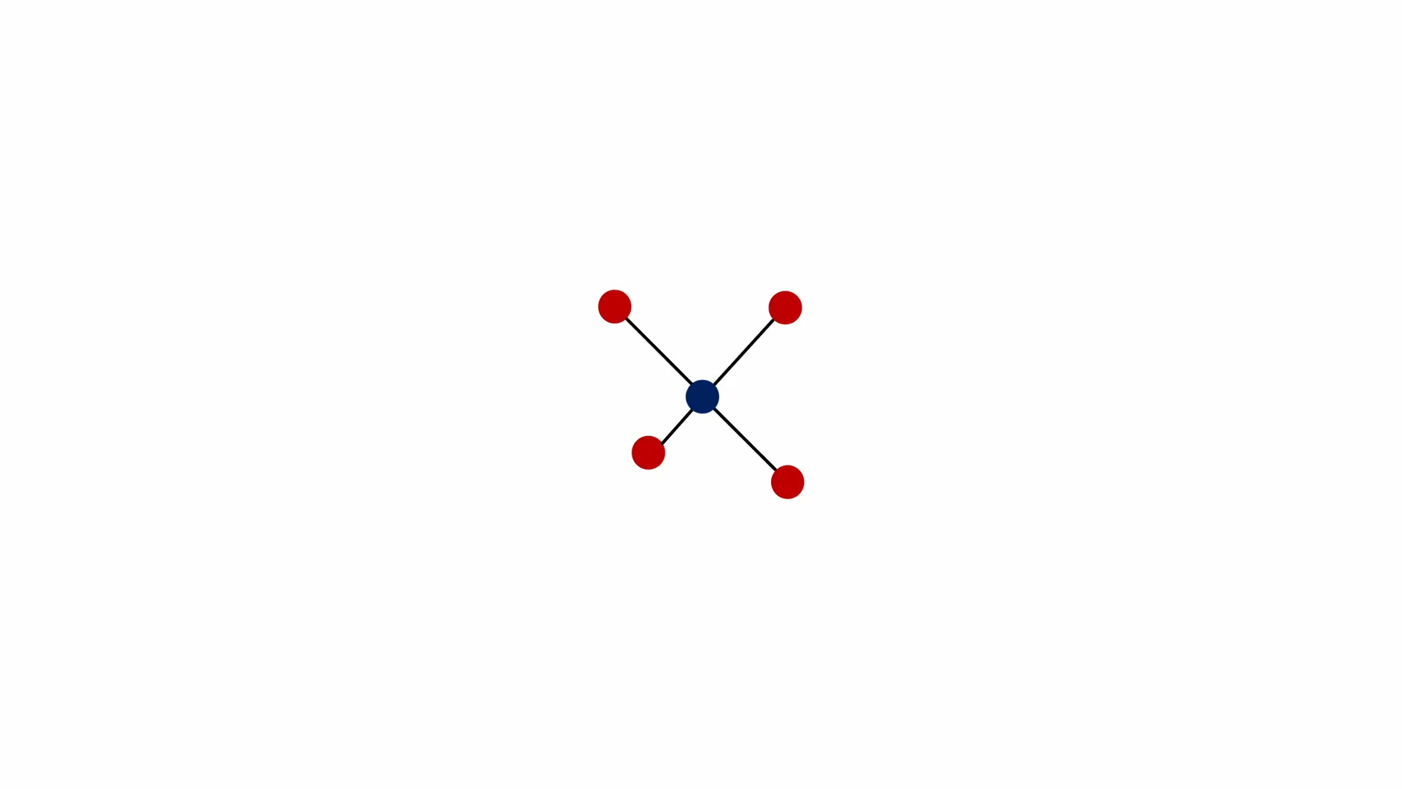
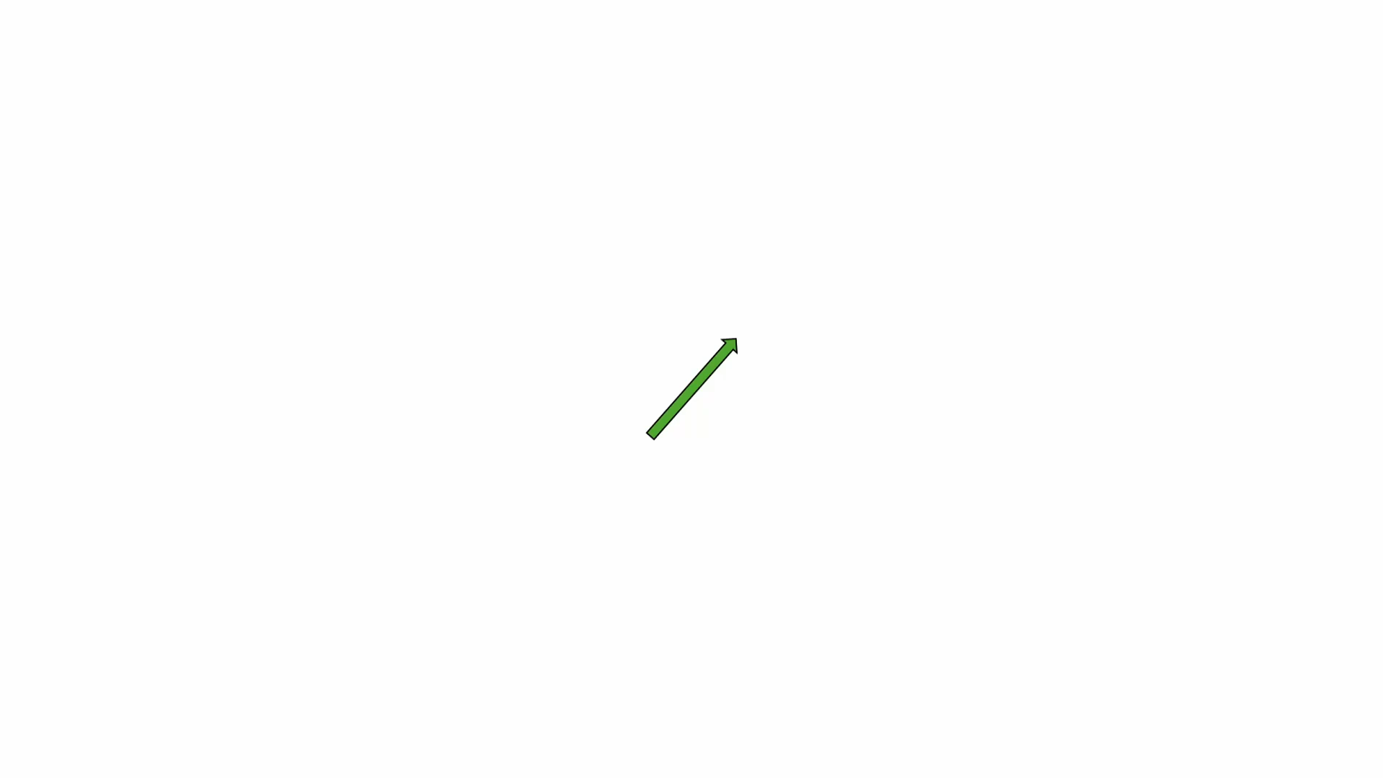
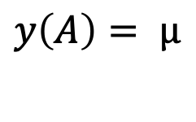
And,
Quantum Mechanical (QM) calculation
$$y\left(A\right)= μ$$
Other properties may have more complex behavior

Slide 8
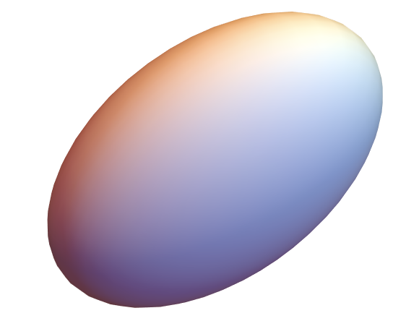
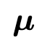
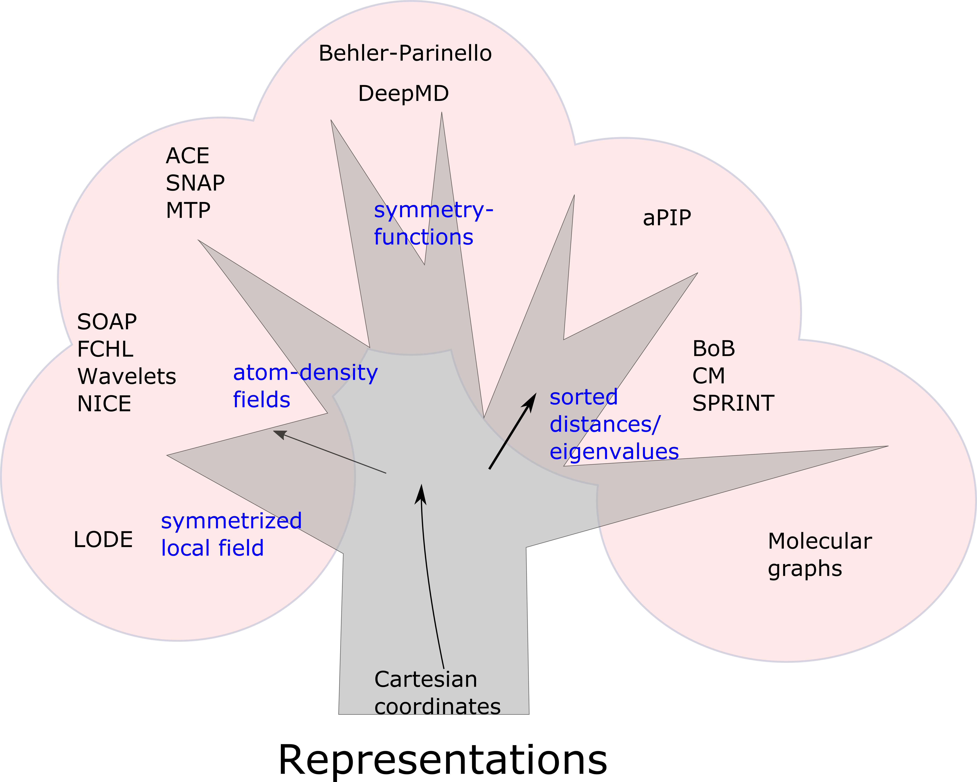
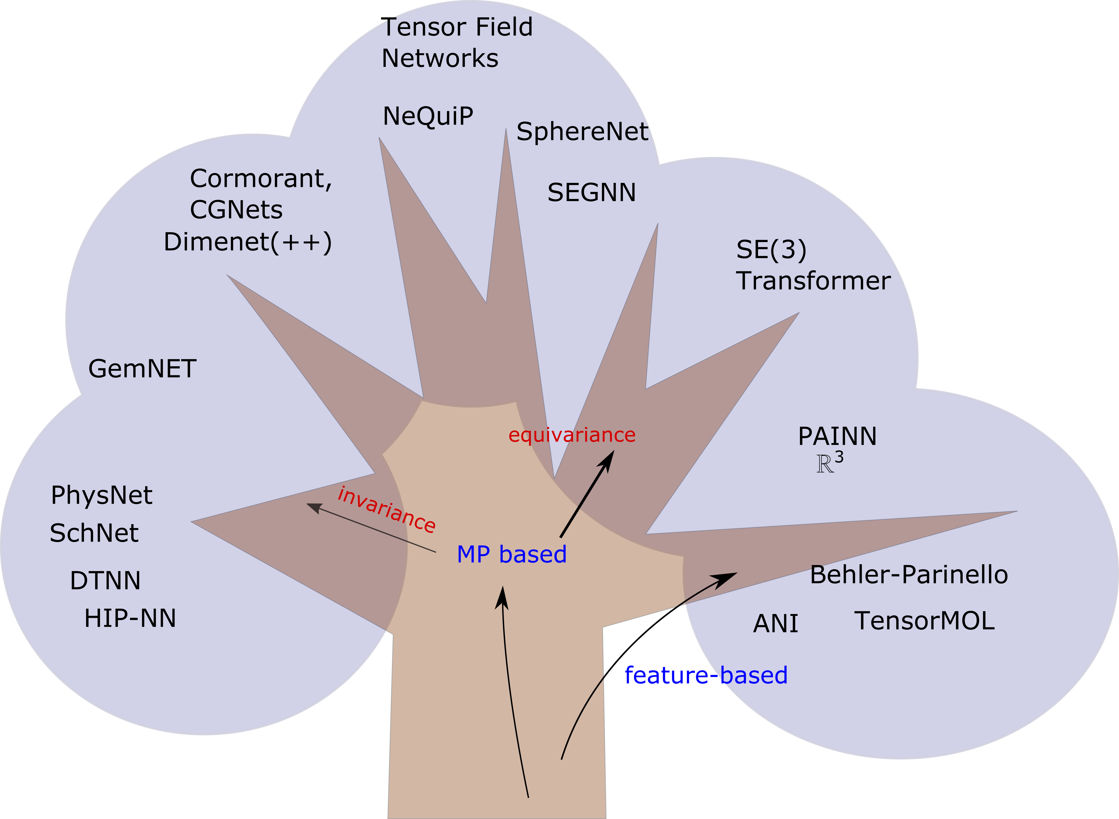

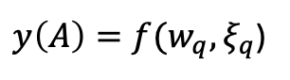
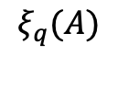
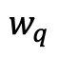
ML models for atomistic properties
end to end
$$y\left(A\right)=f(A)$$
QM
Polarizability
$y\left(A\right)=f(w_{q}, ξ_{q}$)
descriptors
weights
$$ξ_{q}(A)$$
$$w_{q}$$
Which descriptor?
ML surrogates for individual properties
How to enhance their expressive power?
AtomicNNs

Slide 9
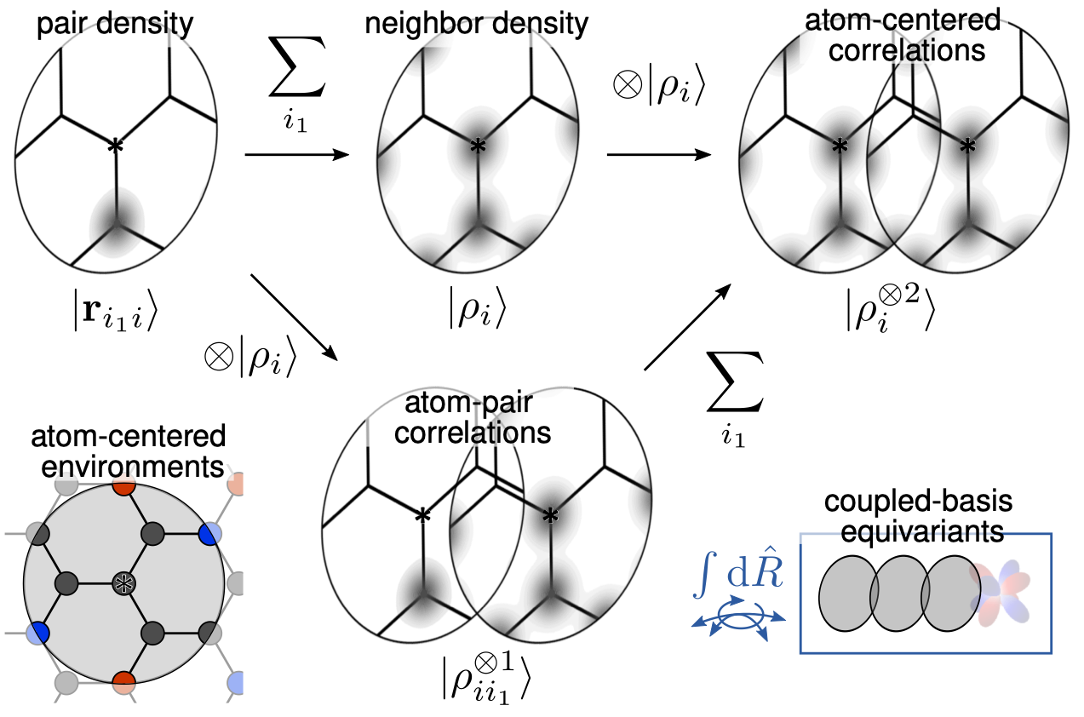













From atoms to structural representations
$$⟨q|$$
$$i$$
*
$$j$$
*
locality
|$r_{ji}⟩$
$$y\left(A\right)=\sum_{i}{y(A_{i})}$$
$$⟨nlm|r_{ji}⟩$$
$$=∫dx ⟨n|x⟩⟨lm|{\hat{x}⟩⟨x|r}_{ji}⟩$$
ACDC framework
A more suitable representation
Bartók et al. (2013) , Drautz et al. (2019), Willatt et al. (2018)

Slide 10

From atoms to structural representations
$$i$$
*
*
$$j$$
*
$$\sum_{j}{}$$
locality
|$r_{ji}⟩$
ACDC framework
Bartók et al. (2013) , Drautz et al. (2019), Willatt et al. (2018)

Slide 11






From atoms to structural representations
$$⟨nlm|ρ_{i}⟩$$
$$i$$
*
*
$$j$$
*
$$\sum_{j}{}$$
|$r_{ji}⟩$
symmetry
locality
$$D_{μμ′}^{\left(λ\right)}(\hat{R})|A_{1};\overline{ρ_{i}^{⊗1}; λμ′}⟩$$
SO(3) irrep
$$⟨q|\overline{ρ_{i}^{⊗1}}⟩$$
$$|\overline{ρ_{i}^{⊗1};λμ}⟩$$
ACDC framework
Bartók et al. (2013) , Drautz et al. (2019), Willatt et al. (2018)

Slide 12










Symmetries abound
$$y\left(A\right)= \sum_{q}{w_{q}\left\langle q \right|A{; ρ}_{i}^{⊗1};LM⟩}$$
$$A_{1}$$
$$μ(A_{1})$$
$$⟨q|A_{1}; \overline{ρ_{i}^{⊗1};1 m}⟩$$
$$w_{q}$$
weights
$$A_{4}$$
= $\hat{R}A_{1}$
$$D^{(1)}(\hat{R})μ(A_{1})$$
$$⟨q|A_{4}; \overline{ρ_{i}^{⊗1};1 m}⟩$$
$$=D_{mm^{′}}^{\left(1\right)}(\hat{R})|{A_{1}; ρ}_{i}^{⊗1};1m′⟩$$

Slide 13









and the invariance of energies
$$y\left(A\right)= \sum_{q}{w_{q}\left\langle q \right|A{; ρ}_{i}^{⊗1};00⟩}$$
$$A_{1}$$
$$E(A_{1})$$
$${|A}_{1}; \overline{ρ_{i}^{⊗1 }}⟩$$
$$w_{q}$$
$$A_{4}$$
= $\hat{R}A_{1}$
weights
$$E(A_{1})$$
$$|A_{4}; \overline{ρ_{i}^{⊗1 }}⟩$$
$$=|A_{1}; \overline{ρ_{i}^{⊗1 }}⟩$$

Slide 14








Pitfall 1: Locality
Train on small molecules
Extrapolate on larger ones
Grisafi, Ceriotti (2019), Grisafi, JN, Ceriotti (2021)

Slide 15








Pitfall 2: Completeness
completeness
Unordered set of pairwise distances
(0,2)
*
*
$$E_{1}$$
(-2,0)
(2,0)
(0,-2)
$$E$$
(-$\sqrt{2}$, $\sqrt{2}$)
($\sqrt{3}$,1)
$$E_{2}$$
many-body approximation
(-$\sqrt{2}$, -$\sqrt{2}$)
($\sqrt{3}$,-1)
$$y\left(A\right)=\sum_{i}{y^{\left(1\right)}\left(A_{i}\right)}$$
ACDC framework
Bartók et al. (2013) , Pozdnyakov et al. (2020), JN et al. (2024)

Slide 16








Hierarchical expansion of properties
*
*
combining angular-momenta
$$⊗$$
$$\left\langle l_{1}m_{1} | ρ_{i}\right\rangle$$
$$\left\langle l_{2}m_{2} | ρ_{i}\right\rangle$$
symmetry
many-body approximation
SO(3) irrep
$$|ρ_{i}^{⊗2};λμ⟩$$
$$y\left(A\right)=\sum_{i}{y^{\left(1\right)}\left(A_{i}\right)}$$
$$+y^{\left(2\right)}\left(A_{i}\right)$$
$$\sum_{\left\{m_{1}m_{2}\right\}}{\left\langle l_{1}m_{1} | ρ_{i}\right\rangle \left\langle l_{2}m_{2} | ρ_{i}\right\rangle ⟨l_{1}m_{1};l_{2}m_{2}|\left(l_{1}l_{2}\right)λμ⟩}$$
ACDC
JN et al. (2020)
Bartók et al. (2013) , Drautz et al. (2019), Willatt et al. (2018)
Biedenharn and Louck (1981)

Slide 17
















Ingredient list for (many) models
*
1
2
4
symmetry
$$⊗$$
3
$$ν=3$$
$$ν=2$$
$$ν=1$$
$$⊗$$
3
2
4
locality
1
Polarizability
$$λ=2$$
≠
completeness
$$λ=1$$
$$λ=0$$
Behler at al. (2007), Bartok et al. (2013) , Drautz et al. (2019), JN et al. (2020)

Slide 18















Bridge to MPNNs
Message
Node
edge
=
MACE
torchmd-net
Batzner et al (2022)
Musaelian et al (2023)
Batatia et al (2022)
Thölke and De Fabritiis (2022)
Update
=
Message Passing
JN, Pozdnyakov, Fraux, Ceriotti (2022)
Batatia et al. (2022)
Bochkarev et al. (2022)
Gilmer et al. (2017), Batagglia et al. (2018)

Slide 19






Extending the menu of ML targets
?
Quantum Mechanical (QM) calculation
$$y\left(A\right)= μ$$
Other properties may have more complex behavior
Densities
Wavefunctions
$$\left\langle i nlm\right| \hat{H} \left. | j n^{′}l^{′}m′\right.⟩$$

Slide 20





























Pandora’s box of symmetries
Size & values depend on the basis set
C
C
C
H1
H2
H3
H4
H1
$$\left\langle i nlm\right| \hat{H} \left. | j n^{′}l^{′}m′\right.⟩$$
$$=$$
$$\left\langle j n^{′}l^{′}m′\right| \hat{H} \left. | i nlm\right.⟩$$
2p_{x}
2p_{y}
2p_{z}
H2
1s
1s
1s
1s
C
2p_{x}
C
H4
H3
C
2p_{y}
Basis set
C
2p_{z}
2p
$m$’
-1
0
1
$$m$$
$$L=0$$
-1
H1
1s
2p
0
$$L=1$$
1
H2
1s
$$|lm⟩|l′m′⟩$$
$$L=2$$
H3
1s
$$\left|LM\right\rangle$$
$$\left\langle lm;l^{′}m^{′}\right|LM⟩$$
$$|LM⟩$$
Captured by spherical harmonics
$$LM$$
H4
1s
Irreducible O(3) representation of each block

Slide 21









Blurring the lines between ML and QM
C
C
C
H1
H2
H3
H4
$$\left\langle i nlm\right| \hat{H} \left. | i n^{′}l^{′}m′\right.⟩$$
$$\left\langle i nl;i n^{′}l′\right| \hat{H} ;LM⟩$$
2p_{x}
2p_{y}
2p_{z}
1s
1s
1s
1s
Node-wise predictions
C
2p_{x}
C
2p_{y}
C
2p_{z}
H1
1s
H2
1s
$$\left\langle i nlm\right| \hat{H} \left. | j n^{′}l^{′}m′\right.⟩$$
$$\left\langle i nl;j n^{′}l′\right| \hat{H} ;LM⟩$$
H3
Edge-wise predictions
1s
H4
1s
$$h_{1}$$
1
$$h_{2}$$
2
5
$$r_{25}$$
$$h_{4}$$
4
$$h_{3}$$
3
Hegde et al. (2018), Schütt et al. (2019), Unke et al. (2022), JN et al. (2022), Zhong et al. (2024)

Slide 22



Learning matrix elements of the Hamiltonian
Noisy “target”
Predicted
The reward of symmetrization
JN, Willatt, Ceriotti (JCP 2022)

Slide 23
Hamiltonian as an ingredient
We shift the focus from the Hamiltonian as a target and start treating it as a model layer
Westermayr et al. (2021), Tang et al. (2024)

Slide 24
ML basis set compression
Westermayr et al. (2021)

Slide 25


















Physical constraints to the rescue
$${\tilde{φ}}_{1}$$
$${\tilde{φ}}_{2}$$
$${\tilde{ψ}}_{1}$$
$${\tilde{χ}}_{1}$$
$$ε_{4}$$
$${\tilde{φ}}_{1}$$
$$ε_{1}$$
$$ε_{3}$$
$$ϵ$$
$${\tilde{φ}}_{2}$$
$$ε_{2}$$
$$ε_{2}$$
ML
$${\tilde{ψ}}_{1}$$
$$ε_{3}$$
$$ε_{1}$$
$${\tilde{χ}}_{1}$$
$$ε_{4}$$
Unphysical resulting intermediate projection!
Cignoni, Suman, JN, Cupellini, Mennucci, Ceriotti (ACS CS 2024)

Slide 26
Physical constraints to the rescue
Cignoni, Suman, JN, Cupellini, Mennucci, Ceriotti (ACS CS 2024)

Slide 27
And, surprise sweet treats
Excitations computed based on the ground-state Hamiltonian with the sTDA approximation
Representative molecules from validation set
Molecules in the training set – but we didn’t train on sTDA excited state spectra!

Slide 28


Transferability across configurations
Training set
The effective Hamiltonian captures the physics of the large basis

Slide 29

Unlock more recipes with differentiable QM
Suman, JN, Pegolo, Türk, Zhang, Chan, Ceriotti (JCTC 2025)

Slide 30






New ingredients → new recipes!
$$α$$
$$y\left(A\right)=\sum_{i}{y\left(A_{i}\right)}$$
$$y\left(A\right)=PySCFAD(\tilde{H})$$
Veit et al. (2020), Suman, JN, Pegolo, Türk, Zhang, Chan, Ceriotti (JCTC 2025)

Slide 31

Take aways
locality
completeness
symmetry
Polarizability
Observables, operators
QM targets have symmetries that can guide a suitable modeling strategy
The design space in ML is vast, but many approaches have shared ingredients and challenges.
What is a good compromise of physics-based inductive biases and data-driven flexibility? When is physical bias too much bias?
Incorporating symmetries is rewarding but also restricts the flexibility of operations.

Slide 32


Thank you!
Suman, JN, et al. (JCTC 2025)
JN, Pozdnyakov, Ceriotti (APL 2024)
JN, Willatt, Ceriotti (JCP 2022)
jnigam@mit.edu

